Slide 1
Upgrading large-scale Enterprise applications to the Cloud
Vilmos Kintera - Head of AX

Slide 2
What can you expect in this session?

Slide 3
What can you expect in this session?
Part I:
History and the business profile of JJ Food Services
Why should we move to the Cloud?!
What is required to run a successful upgrade?
What can we do now to get ready?
Part II:
Code upgrade best practices
Preparations for a data upgrade
Relocating to the cloud

Slide 4

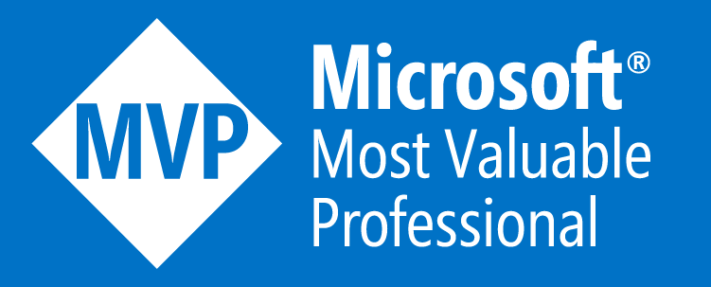
Meet Your Presenters
Vilmos Kintera
Head of AX @ JJ Food Service Limited, United Kingdom
CEO @ DAXRunBase Consulting LLC
https://www.daxrunbase.com/
https://www.twitter.com/DAXrunBase

Slide 5
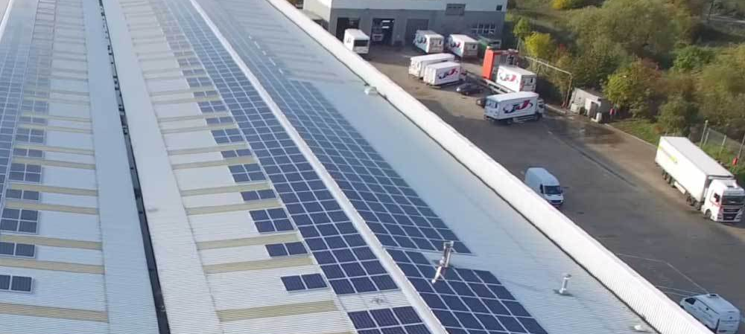
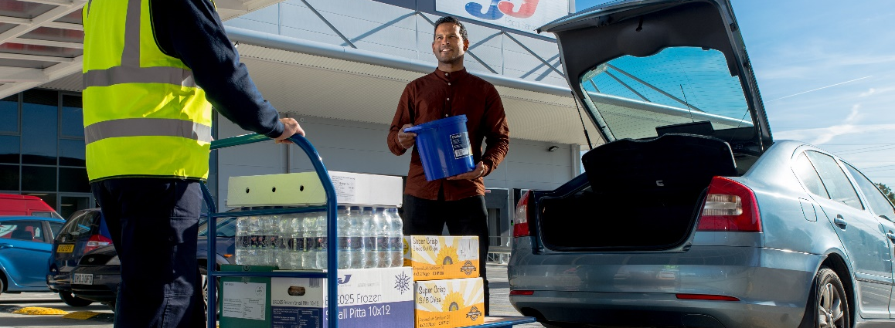
Meet the Company
JJ Food Service Limited
Omnichannel Business-to-business (B2B) sales of food and non-food products
14+ years of transactional history, using Microsoft Dynamics AX from version 3.0 to 2012 R3
11 branches and warehouses across the UK
60.000 customers
100+ delivery vehicles

Slide 6
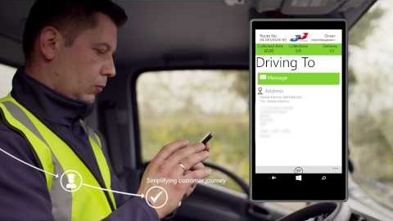
Meet the Company

Slide 7
Application economy for the Cloud

Slide 8
Application economy for the Cloud
Our Application economy consists of multiple software and solutions integrated with Dynamics AX

Slide 9
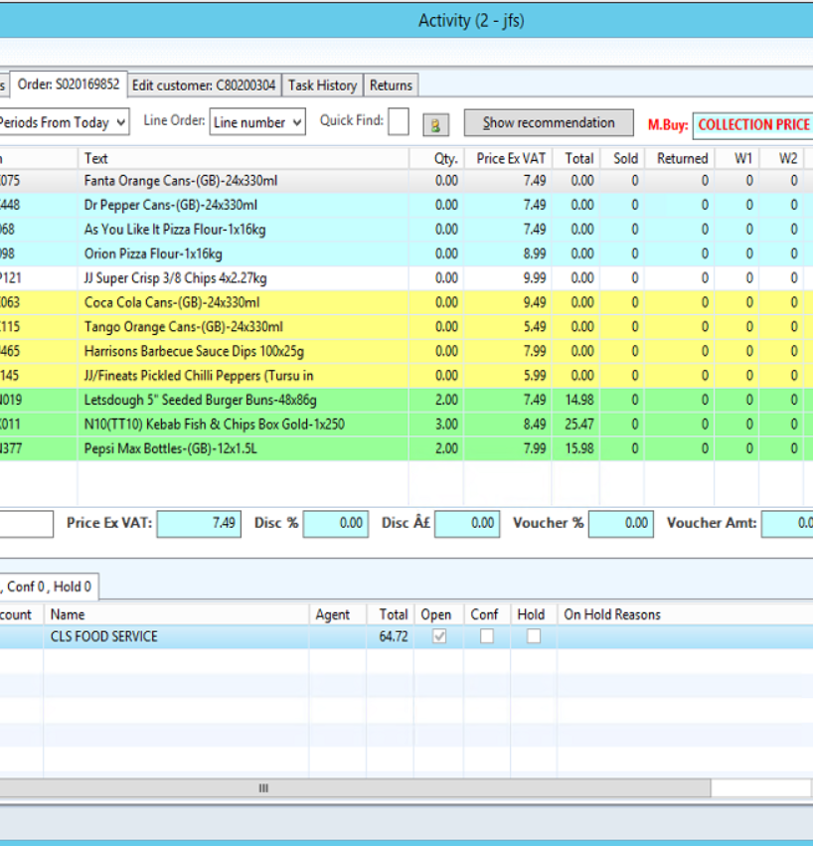
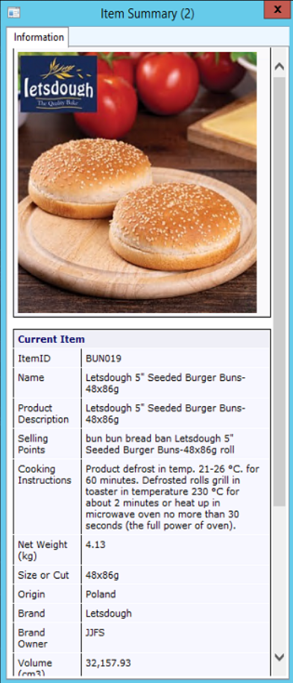
Application economy for the Cloud
Microsoft Dynamics AX 2012 R3 ERP system is at the heart of our operations
Everything taps into the source of information just-in-time, which is AX.

Slide 10
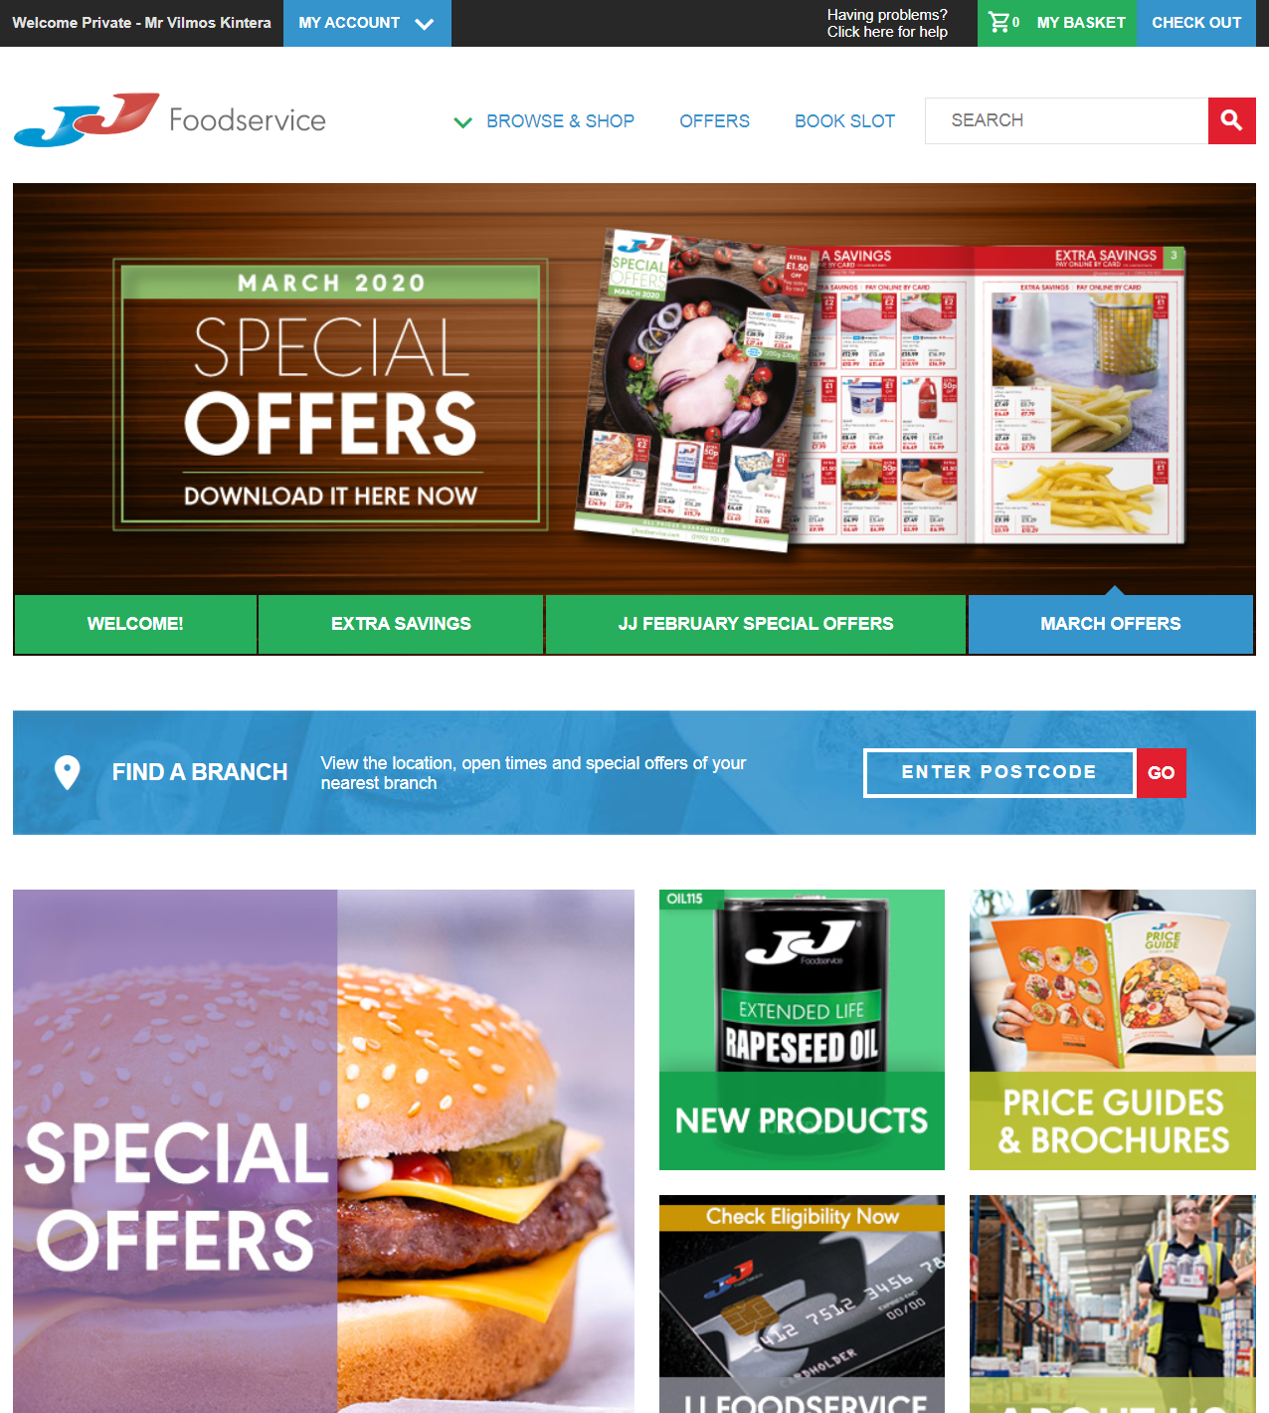
Application economy for the Cloud
In-house developed eCommerce portal for online sales channel
Some features implemented:
Real-time product, customer, ATP details
Basket recommendations
Frequently bought together items (upsell, cross-sell)
Olympus Payment gateway with wallet, 3D-secure checkout
Multi-tiered price discounts based on region and business profile

Slide 11
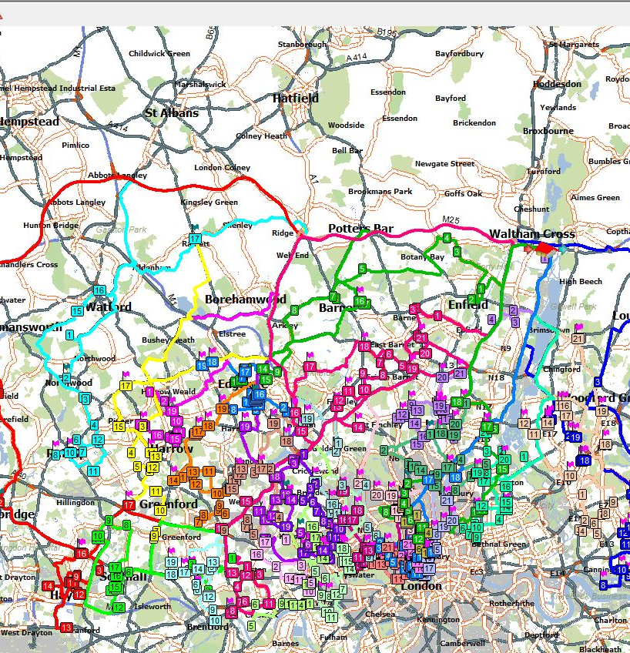
Application economy for the Cloud
RoadNet route planning and shipping solution
Complex route planning for shipping with 20+ stops each using a 100+ vehicles daily.

Slide 12
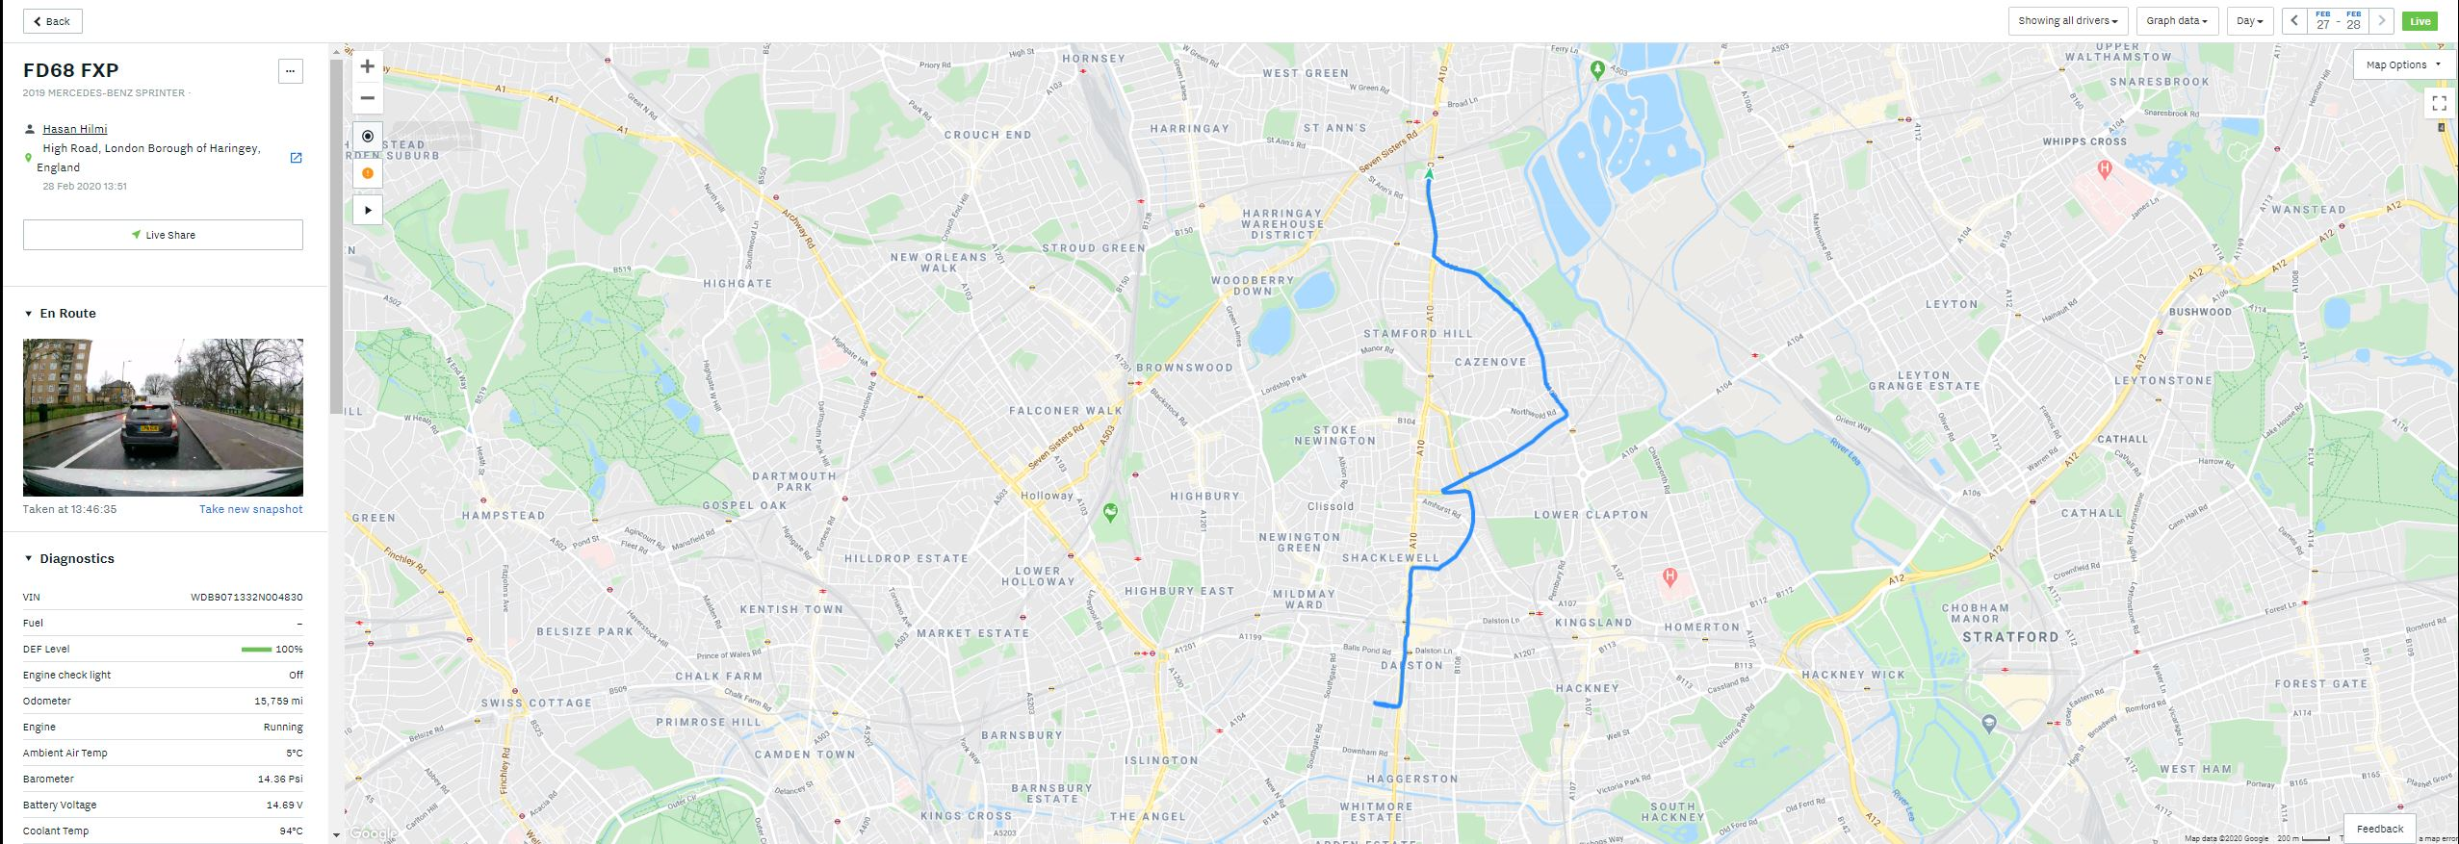
Application economy for the Cloud
Samsara IoT-based telemetry monitoring of lorries

Slide 13
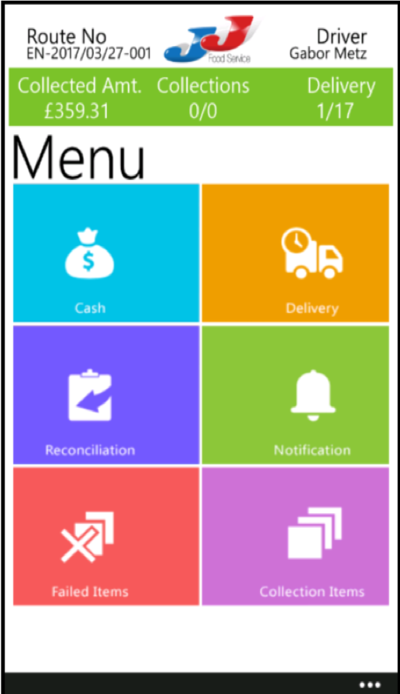
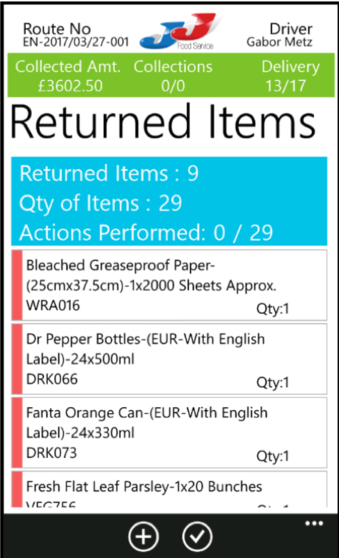
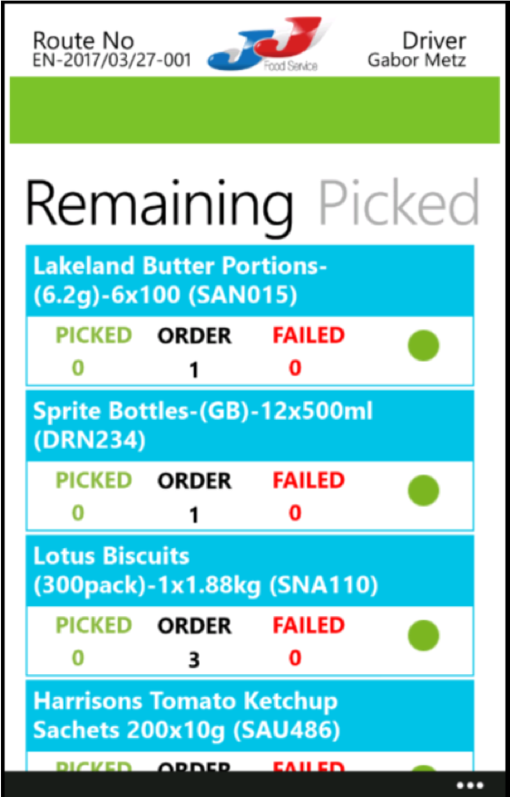
Application economy for the Cloud
Drivers’ Delivery app
Orders available for editing at the tip of their hand, printing invoices on-site, completely eliminating subsequent credit notes.

Slide 14
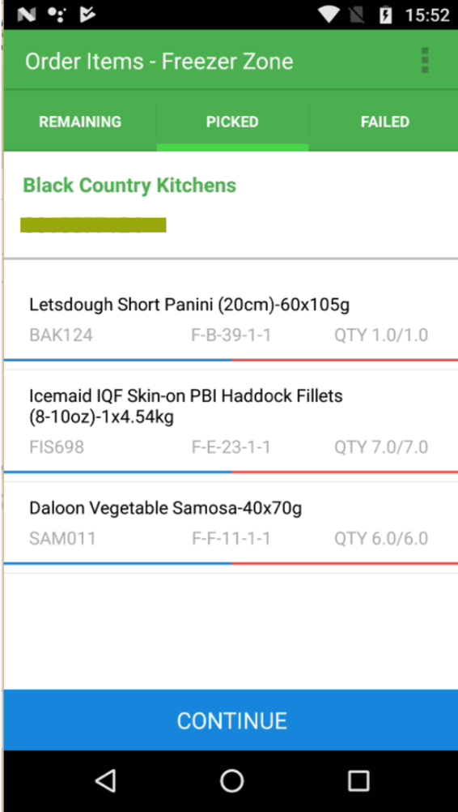
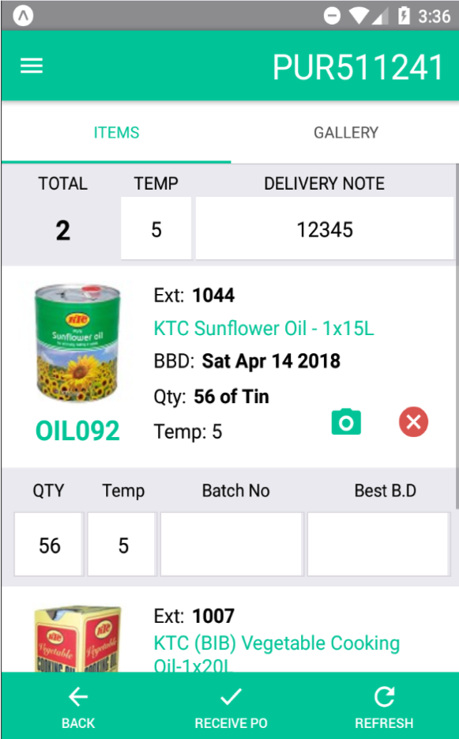
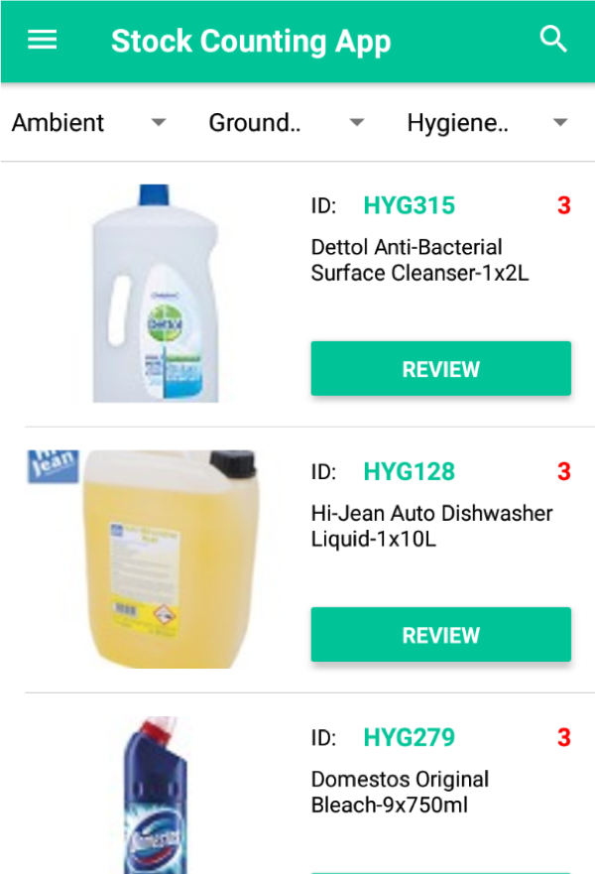
Application economy for the Cloud
In-house developed Warehouse management applications
Stock cycle counting app
Picking app
Goods-in app

Slide 15
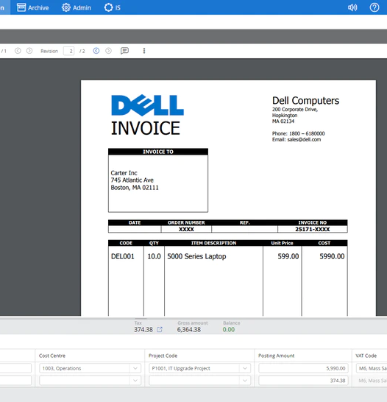
Application economy for the Cloud
SoftCo AP automation
Automated processing and posting of purchase invoices arriving via e-mail.

Slide 16
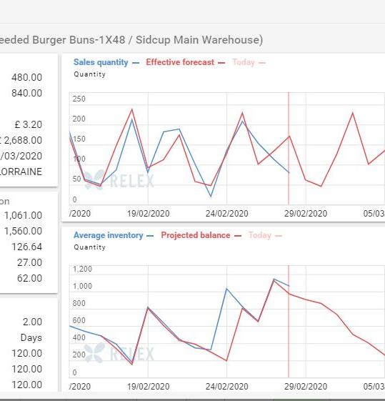
Application economy for the Cloud
Relex Forecasting and Master Planning
Automated purchase order creation based on previous historical sales, stock levels, market trends.

Slide 17
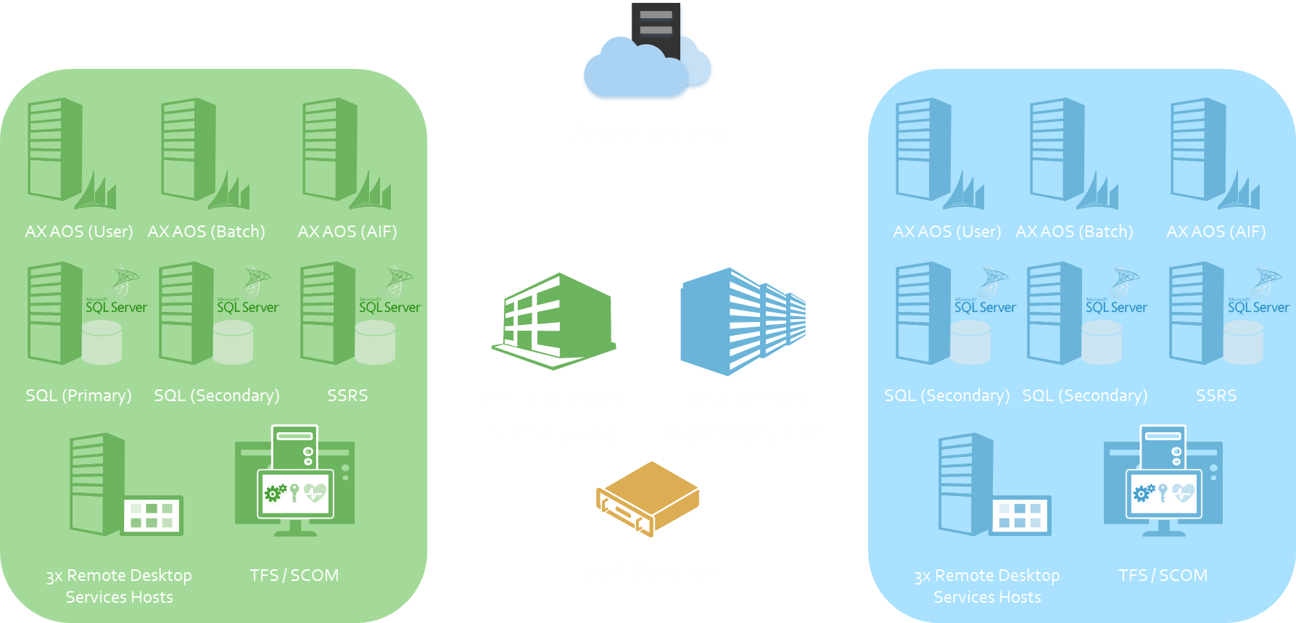
Application economy for the Cloud
Complex infrastructure using Nutanix in a High-Availability cluster

Slide 18
Application economy for the Cloud
Journey of our system implementation:
2004-2005: Initial implementation of Axapta 3.0 with eBECS
2007: Upgrade to Axapta 4.0 with eBECS (TAP)
2009: Upgrade to Microsoft Dynamics AX 2009 inhouse (TAP)
2012: Upgrade to Microsoft Dynamics AX 2012 RTM inhouse (TAP)
2017: Upgrade to Microsoft Dynamics AX 2012 R3 inhouse
2019-2020: Upgrade to D365 for Finance + Supply Chain Management

Slide 19
Application economy for the Cloud
<DEMO>

Slide 20
Why should we upgrade?!

Slide 21

Why should we upgrade?!
“Digital transformation is the change associated with the application of digital technology in all aspects of human society.”
“It is not the strongest of the species that survives, nor the most intelligent that survives. It is the one that is the most adaptable to change.”
- Charles Darwin

Slide 22
Why should we upgrade?!
Disruptive technology we are using relies on historical data, which has great value for our company:
Predictive analytics with AI and Machine Learning:
Pre-filling customer sales basket based on previous purchases with personalized items
Up-selling items for customers based on the category they fall into (restaurant type)
Frequently bought together items using pattern recognition
IoT sensors in Delivery vehicles for measuring temperature deviations in freezer and chiller compartments
Generating Call sheets for Telesales Agents
Setting Item prices based on Purchase and Sales trends using PowerBI reports
Keeping track of Customers for churn and business ownership changes

Slide 23
Why should we upgrade?!
What does it currently cost to run AX 2012 R3?
IT staff (ERP, Infrastructure, Networking, HelpDesk, SQL)
Software maintenance fee
New hardware every 5 years (or less) due to vendor warranty
Maintaining a Disaster Recovery site in an active-active setup
Redundant ISP line lease with low latency between sites

Slide 24
Why should we upgrade?!
What will it cost to run MSDyn365FO?
IT staff (ERP, Infrastructure, Networking, HelpDesk, SQL)
Software maintenance fee
New hardware every 5 years (or less) due to vendor warranty
Maintaining a Disaster Recovery site in an active-active setup
Redundant ISP line lease with low latency between sites
Good internet connectivity for the chosen Azure site (ExpressRoute?)
Storage fee for the DB

Slide 25
Why should we upgrade?!
Pros
Cons
Evergreen version with regular feature updates
Reduction in maintenance effort
Upgrading becomes simpler with Extensibility model
Scalability based on business growth
Better support from Microsoft FTEs
License cost predictability and model changes
Relying on Microsoft for releases to Production

Slide 26
Planning, effort and execution

Slide 27
Planning, effort and execution
What is required to relocate to the cloud?
Assess and identify what software to keep or replace
Raw technical upgrade of the codebase using Extensibility
Data upgrade / migration
Functional testing to identify gaps in features and configuration
Redesign and/or clean implementation of business requirements
Test case development, automated testing scripts

Slide 28
Planning, effort and execution
What can you do now to prepare for an upgrade?

Slide 29
Planning, effort and execution
Functional upgrade:
Standardize customized features
Reconfigure the system
Utilize new functionality
Technical upgrade:
Remove unused objects (tables, indexes, business logic, …)
Redesign deprecated features (AIF, Document attachments, Direct SQL, …)
Data upgrade:
Purge and Archive unnecessary data
Prepare the Database for transfer to the cloud

Slide 30
Planning, effort and execution
Our transactional database is currently at 1.7 TB
We have done a trial data upgrade and it is possible, however a decision for upgrade depends on many factors.
For a 24/7/365 business we cannot have a downtime required to relocate our database to Azure.

Slide 31
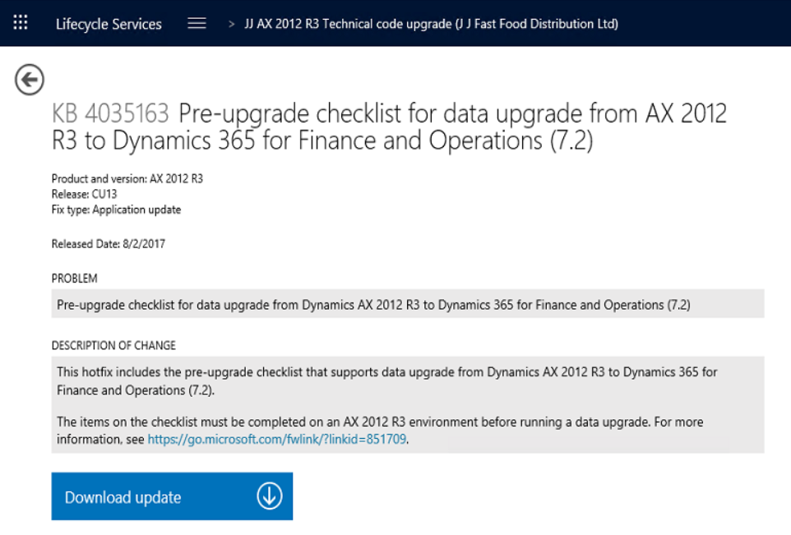
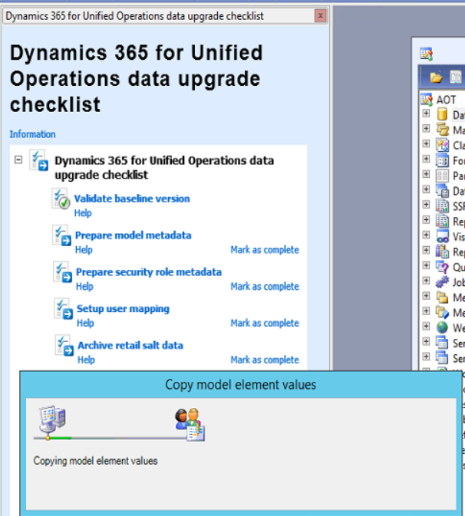
Planning, effort and execution
Code upgrade steps on a high level:
Install D365FO modelstore project in AX 2012 to prepare copying the _model DB content into the actual database
Export, upload and process AX ModelStore on LifeCycle Services’ “Code upgrade” tool
Clean up errors and convert overlayered code into extensions

Slide 32
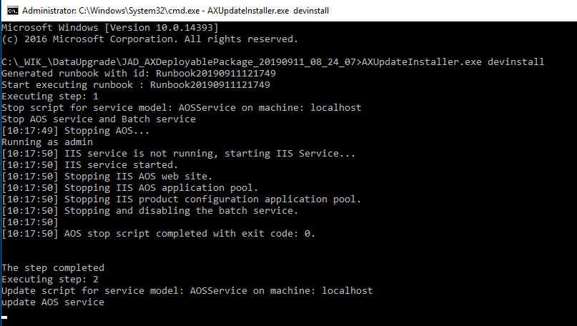
Planning, effort and execution
Data upgrade steps on a high level:
Finish code upgrade for metadata objects (Data types, Tables, Views, Entities)
Generate Software deployable package with error-free metadata objects
Deploy error-free metadata and AX 2012 DB on a VM
Run the AX2012DataUpgrade software deployable package applicable for your version

Slide 33
Planning, effort and execution
What is expected from the business?
Key Users must be selected
Data sanitization
Preparation of Test cases
End-user training
Execute User Acceptance Test cycles
Sign-off for GoLive

Slide 34
Planning, effort and execution
How long does it take? It depends on the complexity of customizations, ISV solutions and alignment of the data.
Code upgrade – 4-8 months
Data cleanup and upgrade – 2 months
Test case and automation development – 2 months
Training, UAT, Sign-off – 2-4 months
Our estimation is that the project is feasible within 1 year.

Slide 35
Q & A

Slide 36
<Lunchbreak>

Slide 37
Upgrade preparations

Slide 38


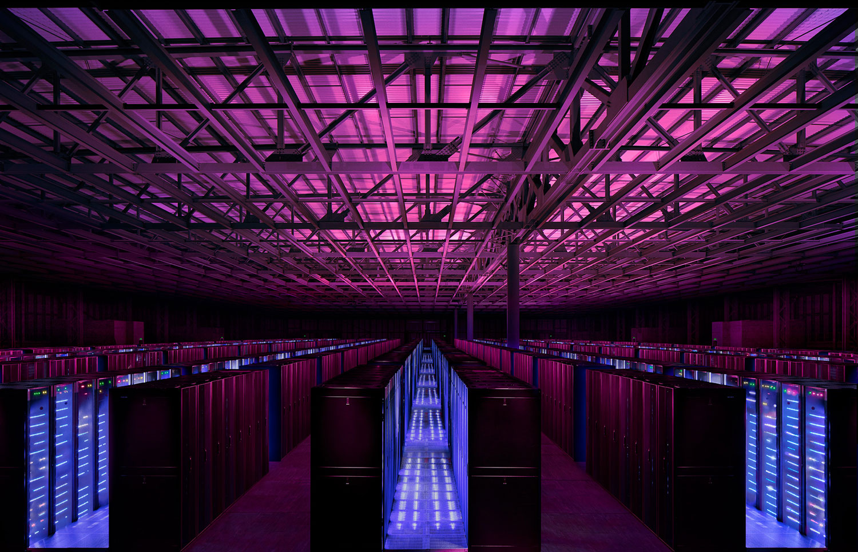
Upgrade preparations
The process of an upgrade consists of the following
Functional upgrade
Technical upgrade
Data upgrade

Slide 39
Upgrade preparations
Pre-requisites for the Data upgrade:
Install the hotfixes required in AX 2012 R3 (KB4035163)
Run the D365FO Data upgrade checklist to prepare model metadata and map user accounts in AX 2012 R3

Slide 40
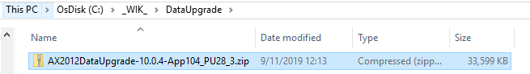
Upgrade preparations
Pre-requisites for the Data upgrade:
Finish code upgrade for metadata objects (Data types, Tables, Views, Entities)
Generate Software deployable package with error-free metadata objects
Prepare the environment which will be running the upgrade (One-box VM, or Local VHD), on a version that has a data upgrade package available.
Download the AX2012DataUpgrade package applicable for your version

Slide 41
Upgrade preparations
Pre-requisites for the Data upgrade:
Deploy the metadata package with your custom code on the VM

Slide 42
Executing the upgrade

Slide 43
Executing the upgrade
The only supported SQL collation is SQL_Latin1_General_CP1_CI_AS for MSDyn365FO as of now in Azure! (Refer to Microsoft Docs)
For most of us it means that at some point the DB needs to be converted.
Options to do this:
Undocumented feature of SQLServr.exe –Q option (seemingly works, but not reliable/recommended by MS)
Exporting the database to an Azure backup format (BACPAC, supported/recommended method)
SQL Server replication to Azure SQL (TBA)

Slide 44
Executing the upgrade
We are only doing test data upgrade cycles as of now, so option B) works.
BACPAC export needs some preparations, since many things in SQL Server are not compatible with Azure SQL:
Drop computed columns | Drop filtered indexes
SELECT sysobjects.name AS TableName, syscolumns.name AS ColumnName FROM syscolumns INNER JOIN sysobjects ON syscolumns.id = sysobjects.id AND sysobjects.xtype = 'U' --User Tables WHERE syscolumns.iscomputed = 1 | SELECT [SchemaName] = s.[Name] ,[TableName] = t.[Name] ,[IndexName] = i.[Name] ,[IndexType] = i.[type_desc] ,[Filter] = i.filter_definition FROM sys.indexes i INNER JOIN sys.tables t ON t.object_id = i.object_id INNER JOIN sys.schemas s ON s.schema_id = t.schema_id WHERE t.type_desc = N'USER_TABLE' AND i.has_filter = 1

Slide 45
Executing the upgrade
Drop views | Drop incompatible Stored procedures
DECLARE @sql VARCHAR(MAX) = '' , @crlf VARCHAR(2) = CHAR(13) + CHAR(10) ; SELECT @sql = @sql + 'DROP VIEW ' + QUOTENAME(SCHEMA_NAME(schema_id)) + '.' + QUOTENAME(v.name) +';' + @crlf FROM sys.views v PRINT @sql; EXEC(@sql); | DROP PROCEDURE [dbo].[XU_ValidateConfigKeyAndLicenseCodeIntegrity] DROP PROCEDURE [dbo].[XU_GetDirtyFlag] DROP PROCEDURE [dbo].[MaintainShipCarrierRole] DROP PROCEDURE [dbo].[Recover_Deleted_Data_Proc]

Slide 46

Executing the upgrade
Drop domain user accounts and schemas | Drop incompatible Stored procedures
 | DROP PROCEDURE [dbo].[XU_ValidateConfigKeyAndLicenseCodeIntegrity] DROP PROCEDURE [dbo].[XU_GetDirtyFlag] DROP PROCEDURE [dbo].[MaintainShipCarrierRole] DROP PROCEDURE [dbo].[Recover_Deleted_Data_Proc] -- Delete XI_* and XU_* manually

Slide 47
Executing the upgrade
MSDyn365FO runs a job in the background to compress all indexes on the DB. As a preparation step, and also to try to speed up the BACPAC export and data upgrade steps we have compressed all clustered and non-clustered indexes.
Get the latest SQLPackage and/or SQL Server Management Studio versions for best compatibility.
https://www.microsoft.com/en-us/download/details.aspx?id=53595

Slide 48
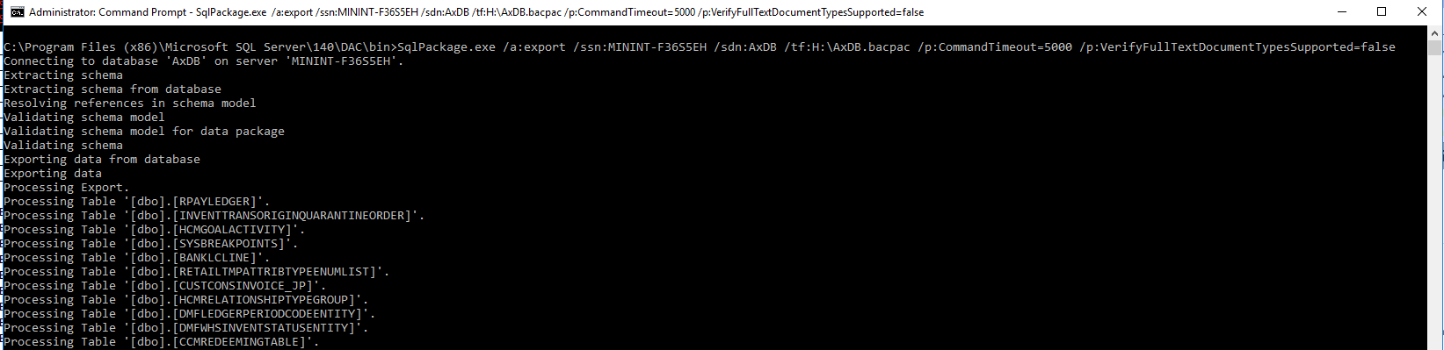
Executing the upgrade
Run the BACPAC export after the AX 2012 R3 DB has been prepared:
SqlPackage.exe /a:export /ssn:MININT-F36S5EH /sdn:AxDB /tf:H:\AxDB.bacpac /p:CommandTimeout=0 /p:VerifyFullTextDocumentTypesSupported=false

Slide 49
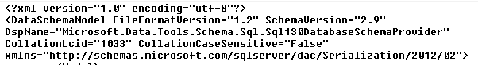

Executing the upgrade
Open the BACPAC with an archive file manager (like 7-zip), since it is just a ZIP archive, and extract the Model.XML file.
Change the collation in the model file (CollationLcid=“1033”and Property Collation = SQL_Latin1_General_CP1_CI_AS), and remove anything else that the SQLPackage might be complaining about later on.

Slide 50
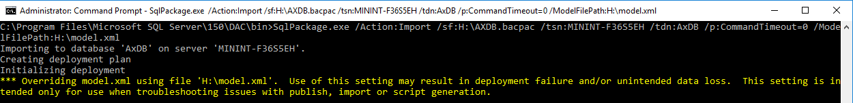
Executing the upgrade
Stop the services (Batch, MR, WWW), rename the empty or demo data AxDB as AxDB_orig in SQL. Import the BACPAC along with the prepped Model.XML file sitting next to it on your VM:
SqlPackage.exe /Action:Import /sf:H:\AXDB.bacpac /tsn:MININT-F36S5EH /tdn:AxDB /p:CommandTimeout=0 /ModelFilePath:H:\model.xml
Once finished, recreate the dropped SQL Views, then you will have your AxDB ready for data upgrade. Likely at this point you might want to do additional custom data or metadata cleanup.

Slide 51
Executing the upgrade
Time to run the actual data upgrade script, which is not different from installing any Software deployable package, except it is doing extra steps to convert your DB:
AXUpdateInstaller.exe generate -runbookid="AX2012DataUpgrade-10-0-4-runbook" -topologyfile="DefaultTopologyData.xml" -servicemodelfile="DefaultServiceModelData.xml" -runbookfile="AX2012DataUpgrade-10-0-4-runbook.xml"
AXUpdateInstaller.exe import -runbookfile="AX2012DataUpgrade-10-0-4-runbook.xml"
AXUpdateInstaller.exe execute -runbookid="AX2012DataUpgrade-10-0-4-runbook"

Slide 52
Executing the upgrade
The script does a couple of steps, including:
Pre-requisites for changing structure of the data
Modify metadata using shadow-copy technique
Edit the decimal values to have only 6 digits instead of 16
Post-scripts for changing structure of the data
Run the ReleaseUpdate cockpit in a Batch process
Final Data Dictionary synchronization

Slide 53
Executing the upgrade
Troubleshooting execution failures at various stages are possible.
The log files are sitting in the RunBookWorkingFolder directory for each components and each steps separately, which is a good starting point.
Later in the process it starts to write in SQL tables like ReleaseUpdateScriptsLog and ReleaseUpdateScriptsErrorLog, from where you could pull relevant details.
In case you have an odd issue within the batch for converting your data, you could hook up against the AOS service and hook in at ReleaseUpdateExecute classes’ Run method, to debug what is going on.

Slide 54
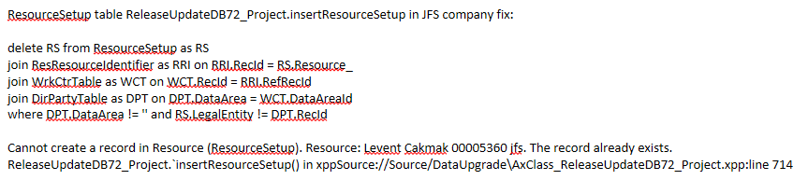
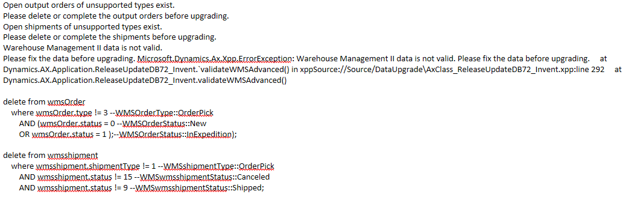
Executing the upgrade

Slide 55
Additional notes

Slide 56
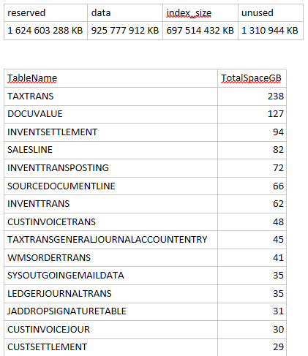
Additional notes
Some facts about our upgrade experience:
Uncompressed SQL DB data composition
Compression has reduced it by 50%

Slide 57
Additional notes
Some facts about our upgrade experience:
SQL Collation change
72 hours on local VHD with 8 cores, 1x512GB OS, 2x2TB SSD Gen3 disks
Data upgrade
72 hours
BACPAC export
30 hours
BACPAC import on Sandbox
30 hours

Slide 58
Additional notes
Microsoft is working with Enterprise customers who want to carry forward large volumes of data on a solution that involved Azure SQL replication.
This would mean that they could put their data in the cloud on an Azure SQL database instance ahead of time, feeding additional transactions done in Production constantly to the intermittent database until cut-over.
It eliminates the requirement of converting the SQL collation, and we do not have to transfer the DB as part of the cut-over processes which saves considerable effort.

Slide 59
Best practices for Code upgrade
<DEMO>

Slide 60
Q & A

Slide 61
Thank You for attending!

